Slide 1

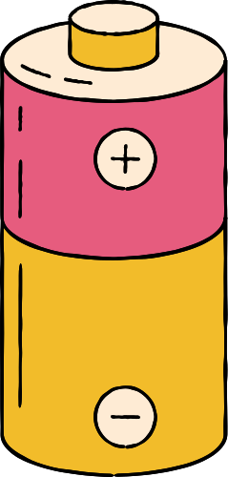

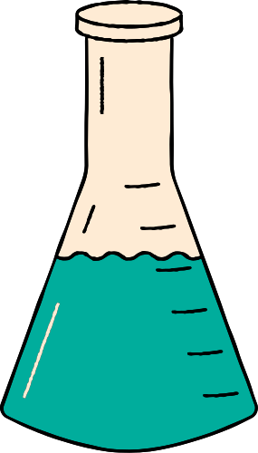







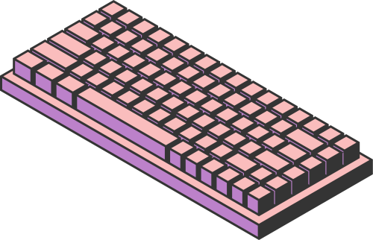
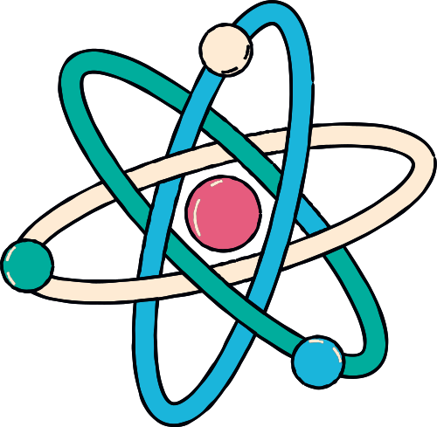

CS182
MOLECULES
PROPERTY CLASSIFICATION
(& REGRESSION)
Team members: Zhangzhi Xiong Tianni Yang Yixuan Chen

Slide 2
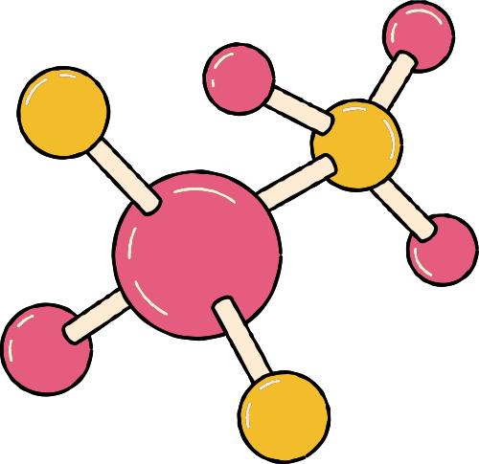
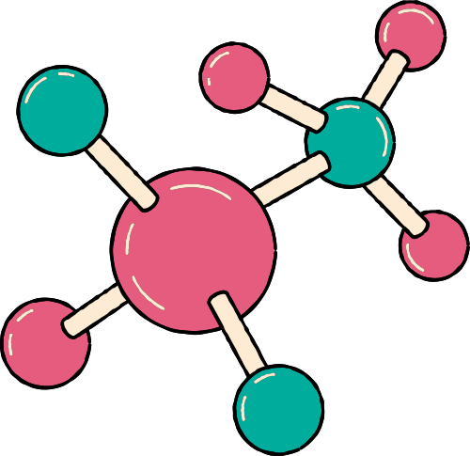
01. INTRODUCTION
OUTLINE
02. METHODS
03. FUTURE PLAN

Slide 3

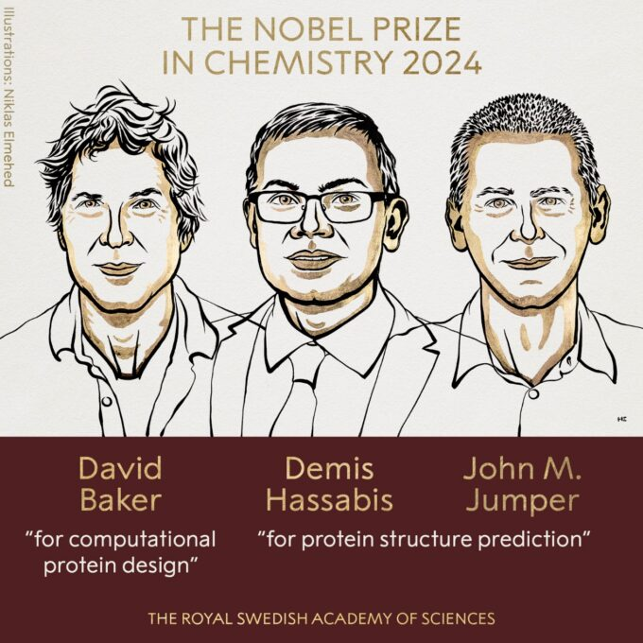

01. INTRODUCTION
AI FOR SCIENCE
Artificial Intelligence (AI) is transforming scientific discovery by accelerating data analysis, modeling complex systems, and generating novel hypotheses across disciplines like physics, biology, and chemistry.

Slide 4




TRADITIONAL METHODS
MACHINE LEARNING
Rely on experiments
Struggle with the vast chemical space
Frequently rely on simplified assumptions, leading to inaccuracies
Costly, risky and time-consuming
Saves time and effort
Improves accuracy
Accelerates innovation in designing novel compounds with desired properties, addressing pressing global challenges in health, energy, and sustainability.

Slide 5
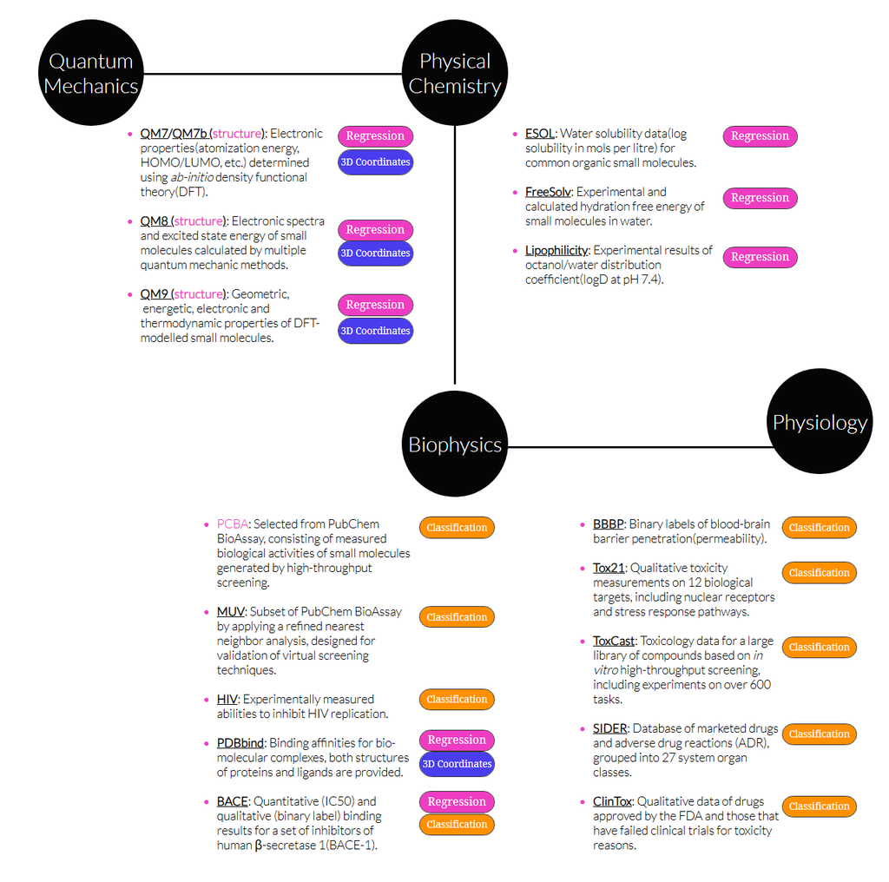
DATASET
Moleculenet
MoleculeNet is a benchmark specially designed for testing machine learning methods of molecular properties. As we aim to facilitate the development of molecular machine learning method, this work curates a number of dataset collections.

Slide 6
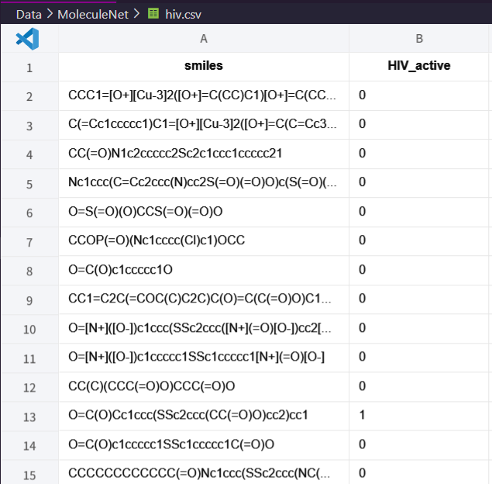
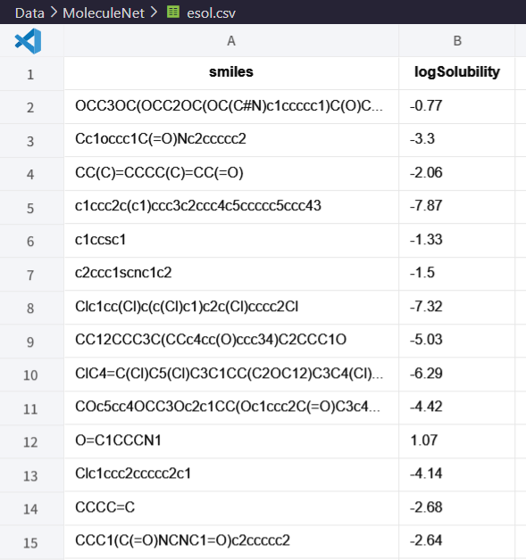
DATASET EXAMPLE
CLASSIFICATION
REGRESSION
HIV: Experimentally measured abilities to inhibit HIV replication.
ESOL: Water solubility data for common organic small molecules.

Slide 7
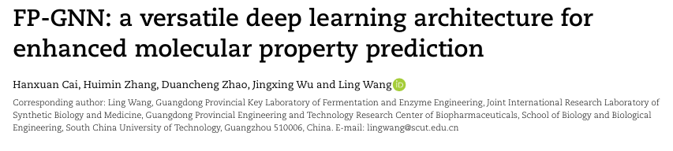
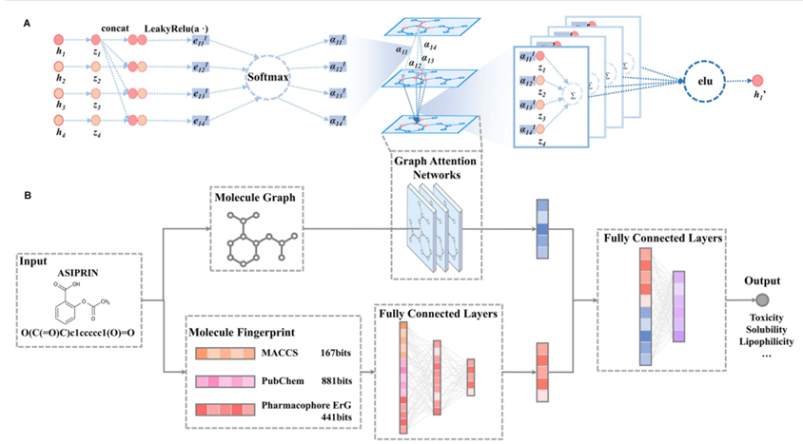
BASELINE
FP-GNN
“In this study, we advanced a novel deep learning architecture, termed FP-GNN, ... FP-GNN was competitive in real-world situation ... assist chemists, biologists and pharmacists in predicting and discovering better molecules with desired functions or properties.”
(From the Abstract of the original paper)
(arXiv:2205.03834)
(github repository: https://github.com/idrugLab/FP-GNN)

Slide 8
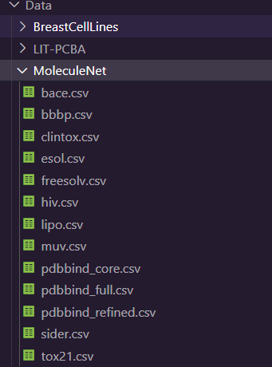
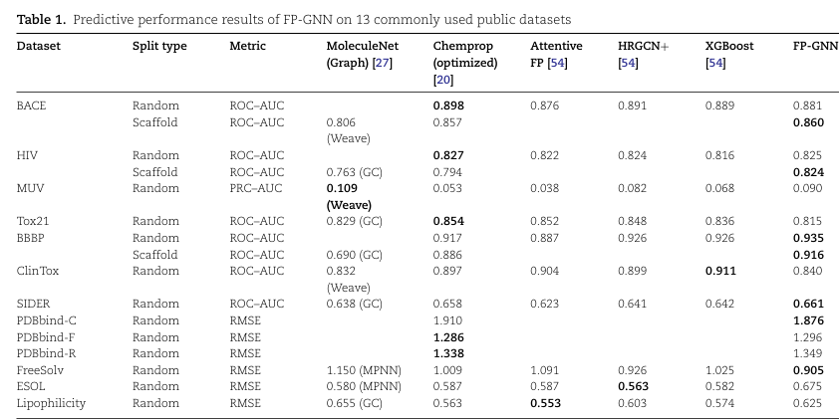
The outstanding performance of FP-GNN on drug discovery-related datasets makes FP-GNN a competitive ML method in drug discovery practice.
The MoleculeNet dataset and corresponding input methods were included, so we decided to use it as our baseline.

Slide 9


02. METHODS
ENCODING
ML METHODS
Molecular Fingerprints
SMILES
Graphs
...
Sequential:
Recurrent Neural Network (RNN)
Transformer
Graphical
Graph Neural Network (GNN)
Graph Attention Network (GAT)
Combined Method
...

Slide 10
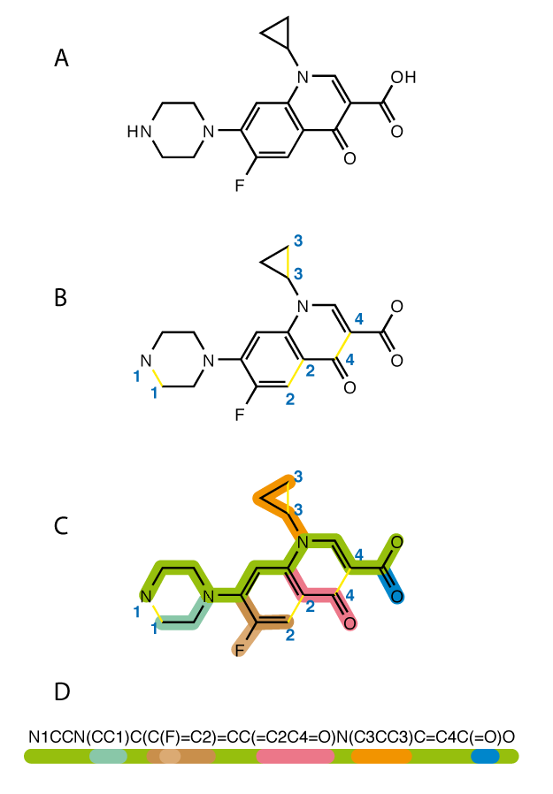
ENCODING
SMILES
The Simplified Molecular Input Line Entry System (SMILES) is a chemical notation for representing molecular structures. It encodes atoms and bonds using simple characters (e.g., "C" for carbon, "=" for double bonds).
In terms of a graph-based computational procedure, SMILES is a string obtained by printing the symbol nodes encountered in a depth-first tree traversal of a chemical graph, which can be converted back to.
From the view point of a formal language theory, SMILES is a word. A SMILES is parsable with a context-free parser.

Slide 11
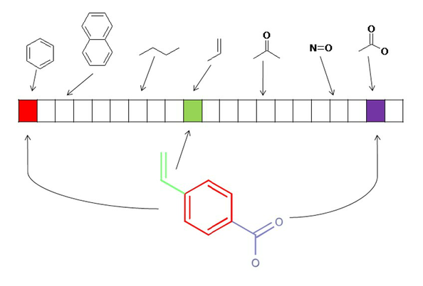
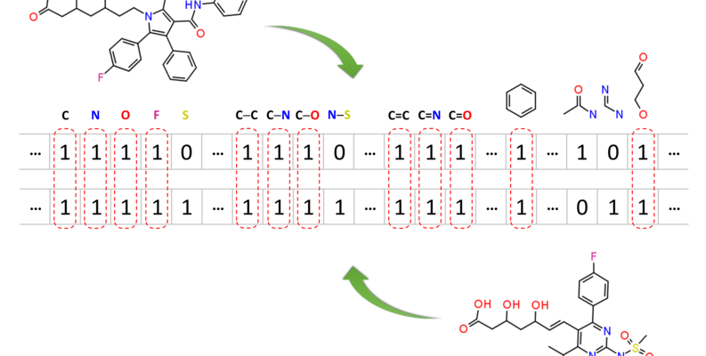
ENCODING
Molecular
Fingerprints
A molecular fingerprint is a binary vector, where each position corresponds to a specific molecular property.
In this representation, a given position X may encode the presence or absence of a particular substructure, with '1' indicating presence and '0' indicating absence.
Various types of molecular fingerprints exist, including PubChem CACTVS fingerprints, Klekota-Roth fingerprints, MACCS fingerprints, and Extended-Connectivity Fingerprints (ECFP).
Pubchem Molecular Fingerprint

Slide 12
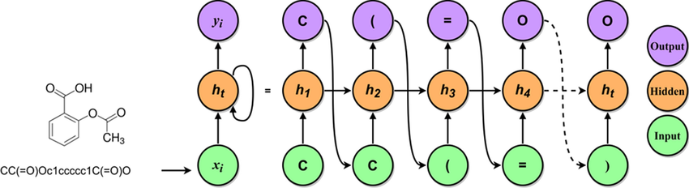
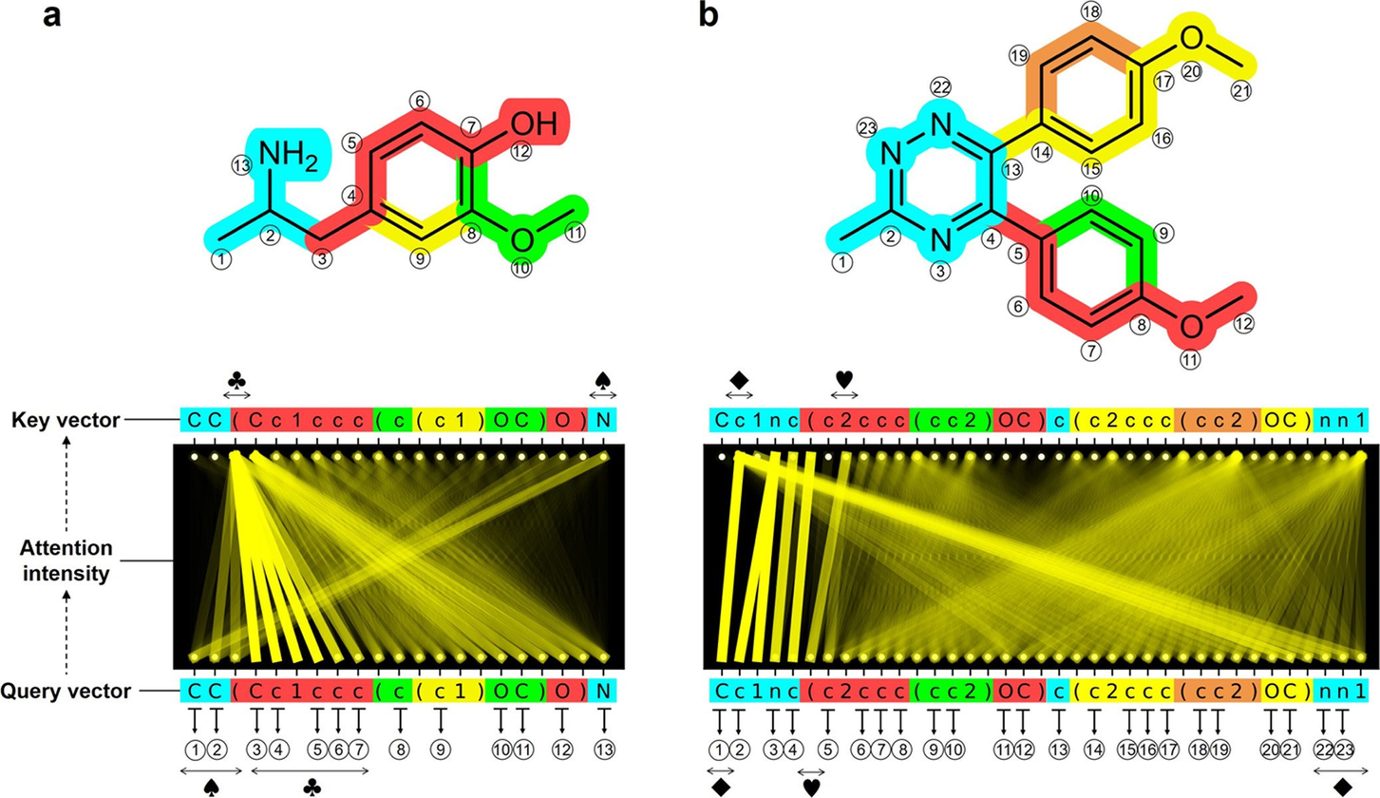

ML METHODS
Sequential Methods
RNN and transformer excel at processing sequential data like SMILES strings for molecular property prediction.

Slide 13
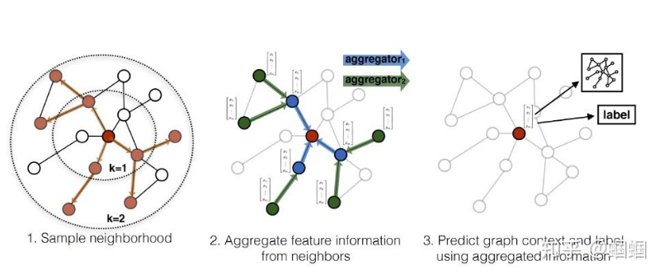
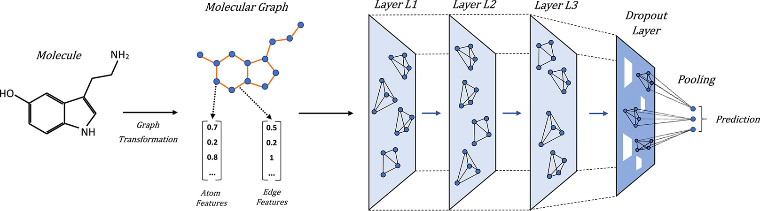

ML METHODS
Graphical Methods
GNNs and GATs model molecular graphs directly, effectively capturing structural and relational information for property prediction

Slide 14

ML METHODS
Conbined Methods
Integrate multiple machine learning approaches, such as GNNs and Transformers, to leverage their complementary strengths for improved molecular property prediction, making full use of the data.

Slide 15
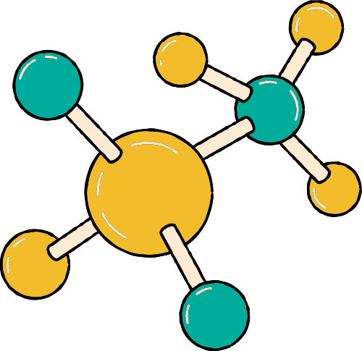

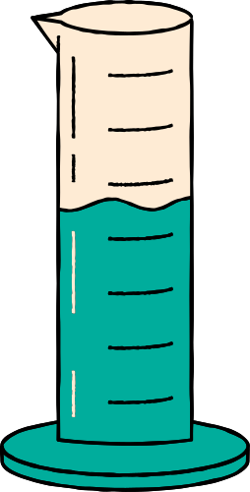
03. FUTURE PLANS
Select through datasets
Build or improve models
Train, predict and evaluate
Classification
(Regression model to predict more numerical properties?)
(Generative model?)
www.reallygreatsite.com

Slide 16

THANK YOU

